Slide 1
EXPLORING EATERIES IN EASTERN SINGAPORE USING FOURQUARE API
Sanat Madkar

Slide 2
Introduction
With the rapid urbanization of the Lion City, several eateries have been established by local vendors to cater to the extensive demand of the multicultural city
Locals of the area or tourists planning a stay in the area (due to the presence of the Airport in the vicinity) can explore the Eastern region of Singapore for eateries.
The number of each individual types of eateries can be used to decide which place to explore depending on each persons choices
The categories of eateries is obtained by the Foursquare API

Slide 3
Libraries and API used
Beautiful Soup – to scrape web data
Pandas, Numpy – for analyzing data
Geocoder – to obtain coordinates of areas
Foursquare API – to obtain venues located in area
Matplotlib – To plot charts pertaining to data
Sklearn.cluster – To implement k-Means clustering
Folium – To display maps

Slide 4
Data Source
The Wikipedia article on different planning areas located in Singapore is used to obtain the different neighborhoods in the city - https://en.wikipedia.org/wiki/Planning_Areas_of_Singapore
The coordinates of the neighborhoods are obtained by the Geocoder API
The venues located in the area are obtained by the Foursquare API

Slide 5
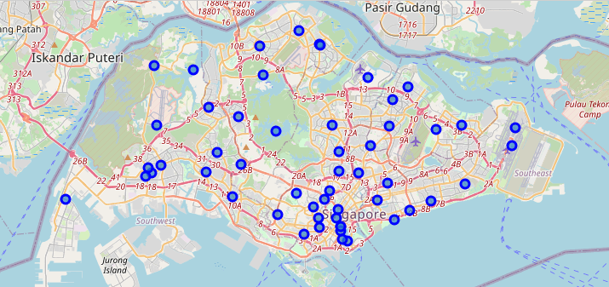
Neighborhoods of Singapore

Slide 6
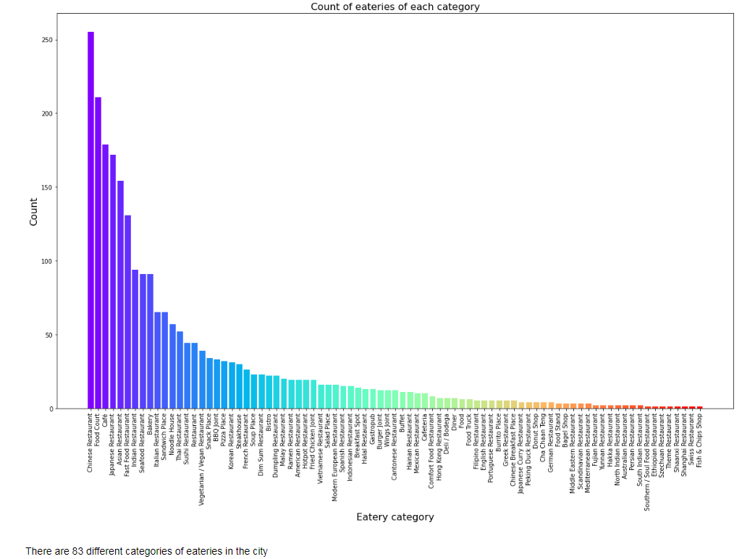
Number of eatery types in Singapore

Slide 7
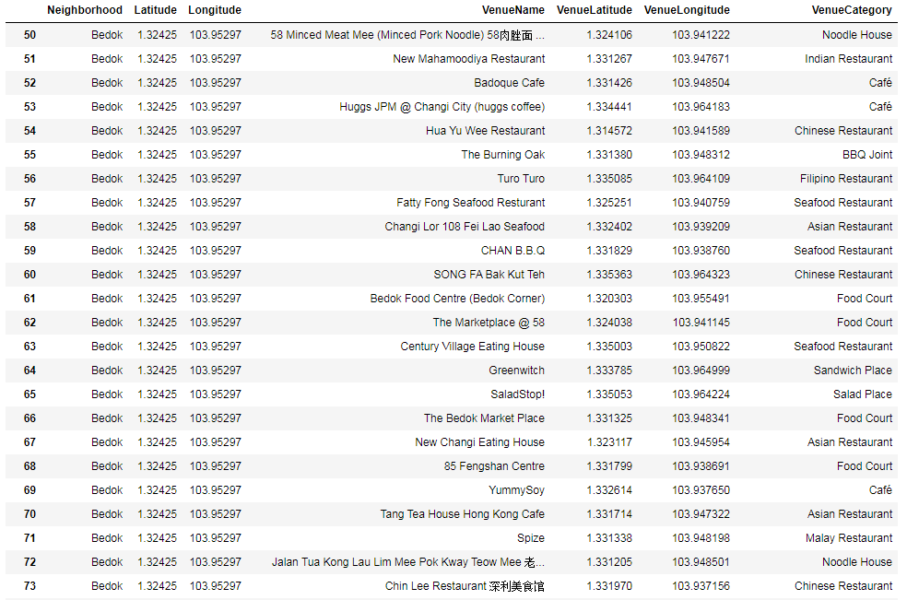
Details of some eateries in Eastern Singapore

Slide 8
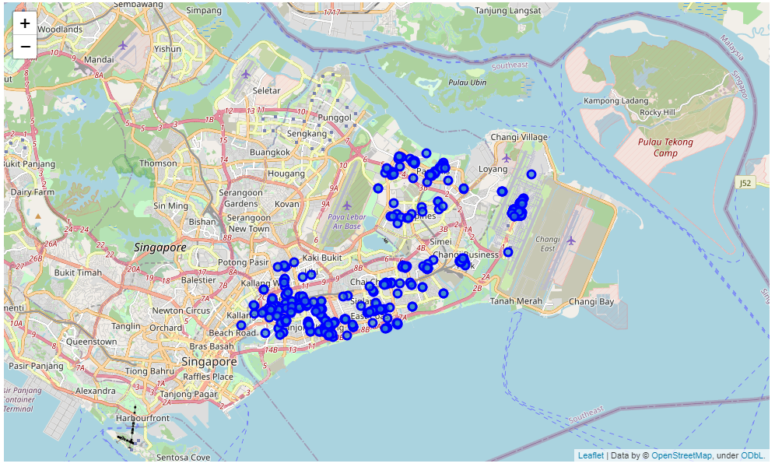
Locations of eateries in Eastern Singapore

Slide 9
One hot encoding
We need to obtain top 10 categories of eateries by area
We do this by using one hot encoding method
Categorical variables are converted to binary vectors
The data of top 10 categories of eateries is clustered to show areas within same clusters showing similar restaurants

Slide 10
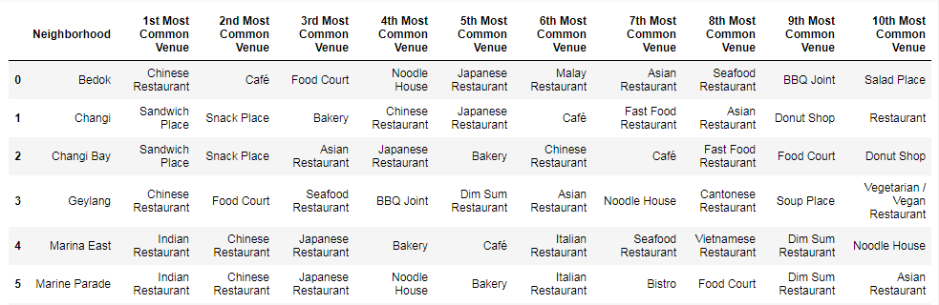
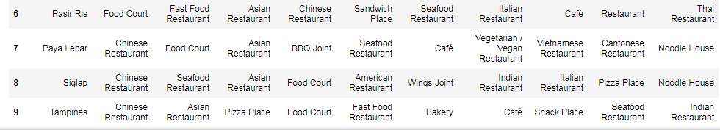
Top 10 most popular categories of eateries by area

Slide 11
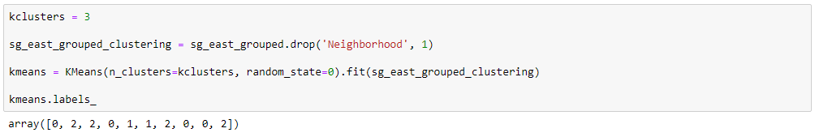
Clustering by k-means method
We use 3 clusters as given below

Slide 12
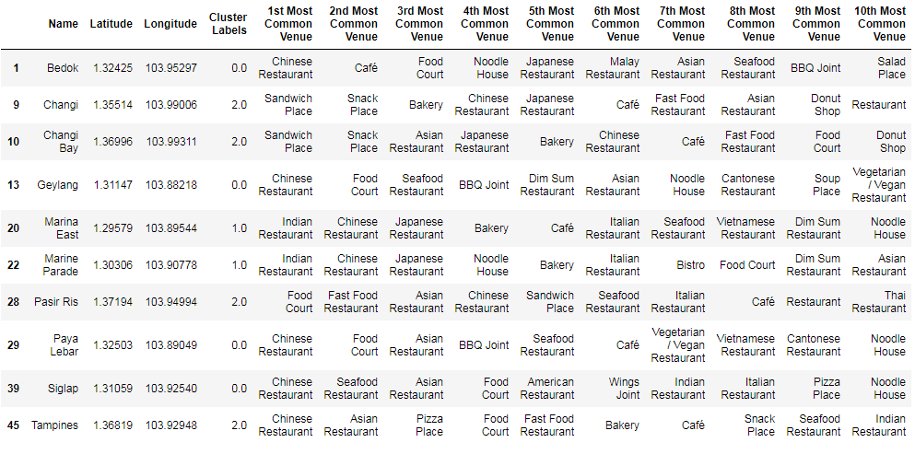
Clustered Neighborhoods

Slide 13
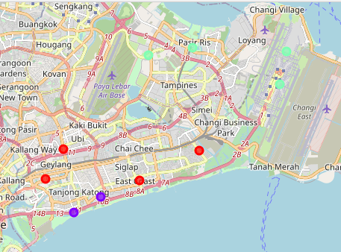
Clustered Areas on a Map

Slide 14
Results
Cluster 0 (Red) consists of neighborhoods of Geylang, Paya Lebar, Siglap and Bedok – primarily residential neighborhoods
Cluster 1 (Violet) consists of neighborhoods of Marine Parade and Marina East – primarily retail and shopping district
Cluster 2 (Light Blue) consists of neighborhoods of Changi, Changi Bay, Tampines and Pasir Ris – located close to the Airport

Slide 15
Conclusion
The cluster 0 is dominated by Chinese restaurants and food courts (hawker centres)
The cluster 1 has varied options ranging from Indian to Japanese and Italian to Bistros
The cluster 2 primarily consists of fast-food joints and snack eateries
A person can choose to explore any of the above areas as they desire according to the eateries located in that respective area

